Slide 1





Course Name object oriented analysis and design
CSC 2210
(Undergraduate)
Software engineering (Undergraduate)
Chapter 6 state diagram
M. Mahmudul hasan
Assistant Professor, CS, AIUB
http://www.dit.hua.gr/~m.hasan

Slide 2
State diagram
OOAD : Activity Diagram
M. Mahmudul Hasan
S.2
MMH
Difference between Statechart diagrams and Activity diagrams:
Activity diagram are used to model how different areas of work behave with each other and interact
State diagrams are used to represent a single object and how its behaviour causes it to change state (i.e., dynamic view of an object)
a State diagram is composed by three components:
(1) state
(2) transitions
(3) events

Slide 3
What is state?
OOAD : State Diagram
M. Mahmudul Hasan
S.3
MMH
State is defined as a snapshot or a milestone of an object’s behavior at a particular point in time
A state represents a time period in the life of an object during which the object satisfies some condition, performs some action or waits for an event
on
Computer
booting
processing
Can be in the following states:
idle
Shutting down
off

Slide 4
Components - State
OOAD : State Diagram
M. Mahmudul Hasan
S.4
MMH
There are three separate notations for state in the Statechart diagram:
State
State
Start State
End State

Slide 5
Components - transitions
OOAD : Activity Diagram
M. Mahmudul Hasan
S.5
MMH
Transitions are used to show flow from one state to another
Transition of an object from a state to another cannot be paused in between
A transition is a progression from one state to another and will be triggered by an event
a State chart diagram can include more than one start/end states
State A
State B

Slide 6
Components – decision points
OOAD : Activity Diagram
M. Mahmudul Hasan
S.6
MMH
Decision points make the diagram more visually appealing by grouping transitions
State A
State B
State C
Take the decision of moving to state B or State C

Slide 7
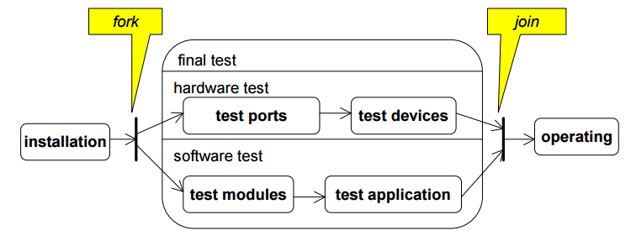
Components – synchronization
OOAD : Activity Diagram
M. Mahmudul Hasan
S.7
MMH
Synchronization bars are used to show were states need to catch up with or wait up for other to join
States can have sub-states and may nested into another state

Slide 8
Components – event
OOAD : State Diagram
M. Mahmudul Hasan
S.8
MMH
Events are indicated directly on the path of a transition from a state to another state
An event is a “happening” that the system needs to know about, e.g. completing an assignment, passing an exam, system crash.
An event may trigger an action by an actor or the system being developed

Slide 9
Components – event
OOAD : State Diagram
M. Mahmudul Hasan
S.9
MMH
Change events occur when a condition becomes true, e.g., when(balance <= 1000)
Call events indicate the receipt of a call for an operation (e.g., call autopilot)
Time events mark the designated period of time, e.g., after(10 seconds)
Manual control
startAutopilot
Automatic control

Slide 10
references
OOAD : Activity Diagram
M. Mahmudul Hasan
S.10
MMH
Booch, G., Rumbaugh, J. & Jacobson, I. (2005). The unified modeling language user guide. Pearson Education India.

